Slide 1

Annual Day
College Program

Slide 2
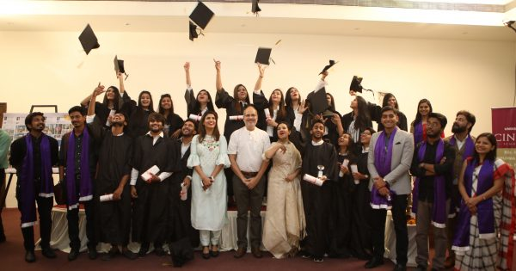
A picture with All

Slide 4
On Annual Day
Program

